Slide 1
Overfitting, Generalization,
Model Evaluation

Slide 2
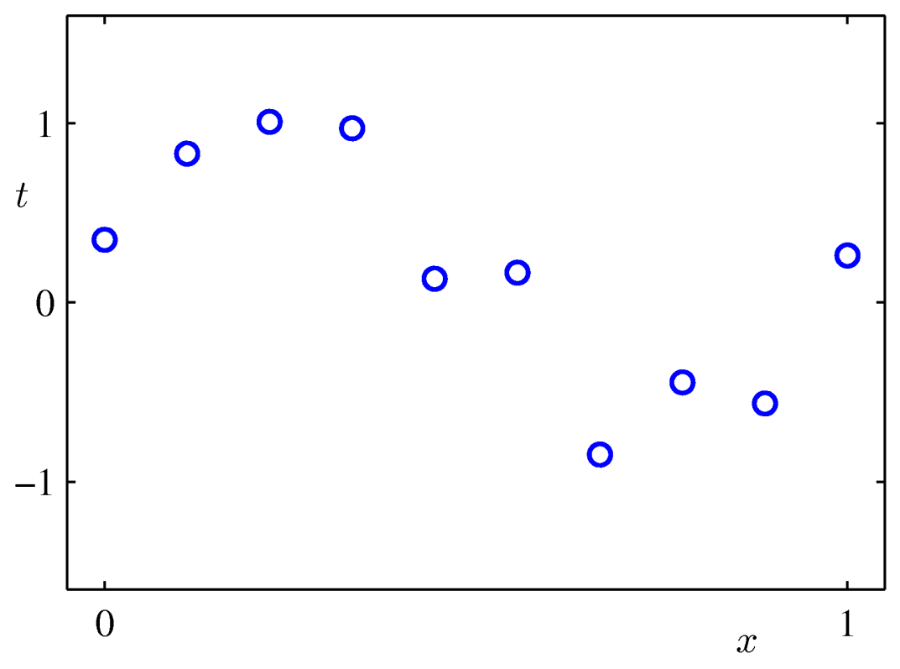
Overfitting vs Generalization
Of Which order polynomial will be best for the data?

Slide 3
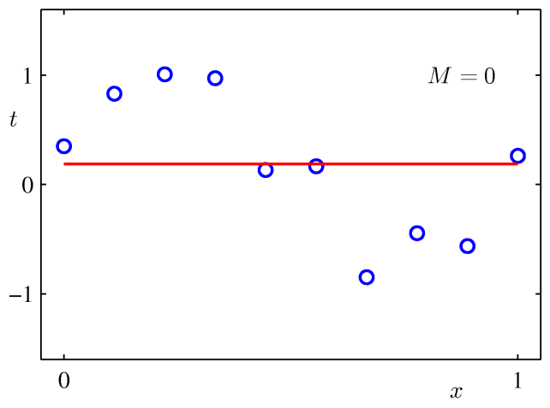
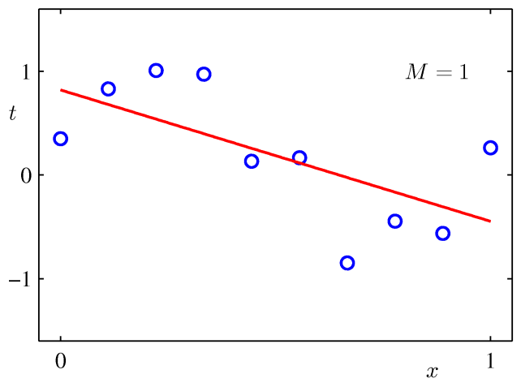
Overfitting vs Generalization
Of Which order polynomial will be best for the data?
  The model which has the least error as much as possible
0th order polynomial
regression
1st order polynomial
regression
This is better
because it has less error

Slide 4
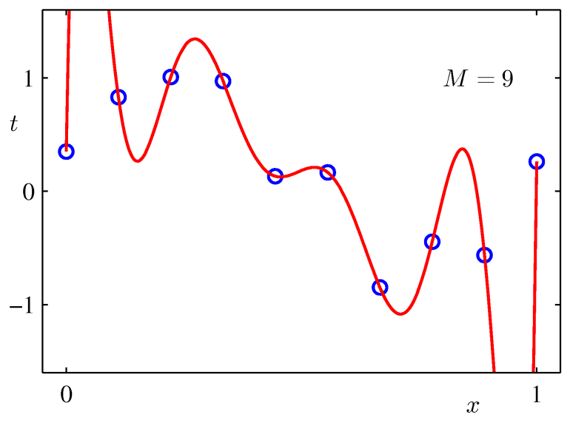
Overfitting vs Generalization
Of Which order polynomial will be best for the data?
  What about this?
  This may be the BEST because the error is ZERO!!
9th order polynomial
regression
Do you agree with this?

Slide 5


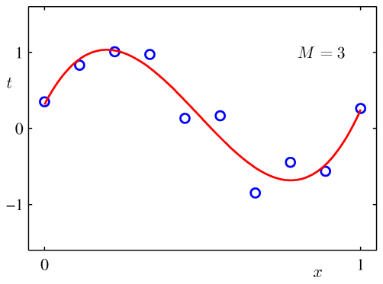
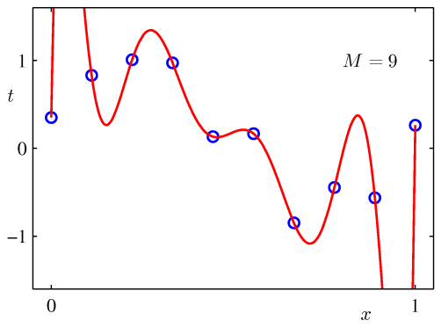
Overfitting vs Generalization
What is the purpose of Machine Learning?
Predict the unknown data
as exactly as possible
based on the given data
Learning the given data
as exactly as possible
vs

Slide 6
Overfitting vs Generalization
Then, which one looks best?
  As the order (M) increases,
    the complexity of model increases
  As the complexity of model increases,
    the model can more exactly learn the given data
    However, the prediction accuracy does not necessarily increase

Slide 7
Model Evaluation
Which model is best?
  You may try several approaches and need to choose one
  You may try several different parameters of a model and need to choose one
Model Evaluations
  Based on Training & Testing data set
  Cross-Validation

Slide 8
Training Set and Test Set
How to choose a good model
  Divide the given data into TRAINING set and TEST set
    Training set and Test set should NOT overlap each other!!
    Both need to be independent as much as possible
  With Training set, build various models
  With Test set, evaluate each model
  Choose the model which shows the best performance with Test set
Data
Training Set
Test Set

Slide 9
Training Set and Test Set
How to choose a good model
Data
1. Randomly Split
Training Set
Test Set
2. Model build
3. Test
Model 1
Model 2
Model n
4. Choose
the best model

Slide 10
Training Set and Test Set
Performance Graph
Error
Testing Error
Training Error
Model Complexity

Slide 11
Training Set and Test Set
Size of Test set
  50~30% of given data
Advantage
  Simple & easy
Disadvantage
  Test set is not used for modeling building. Waste of data
  Data is randomly split
    Evaluation can be significantly different depending on data split
  => Any good idea?

Slide 12
Training Set and Test Set
Data Waste & Random Split
Split 1
Split 2
Data
Data
Training Set
Test Set
Training Set
Test Set
Bad performance
Good performance
Model
Model

